Slide 1
Python UNO Bridge connection to LibreOffice
A hampug presentation
2015 May 11
Ian Stewart
https://github.com/HamPUG/

Slide 2
Python UNO Bridge - Abbreviations
The Python-UNO bridge allows access to the LibreOffice API's from the Python scripting language.
UNO - Universal Network Objects
URE - Universal Network Object Runtime Environment
UNO is the component model used in the OpenOffice.org and LibreOffice computer software application suites. It is interface-based and designed to offer interoperability between different programming languages, object models and machine architectures, on a single machine, within a LAN or over the Internet.
UNO's operate within the UNO Runtime Environment (URE)
The calls between components from different UREs are bridged by UNO.
UNO is developed by the OpenOffice.org / LibreOffice community

Slide 3
Python-UNO Bridge – Installation and Importing
Installation:
$ sudo apt-get install python3-uno
Dependencies...
libc6 | Embedded GNU C Library
libgcc1 | GCC support library
libpython3.4 | Python runtime library (version 3.4)
libreoffice-core | Office productivity suite
libstdc++6 | GNU Standard C++ Library v3
python3 | interactive high-level object-oriented language
uno-libs3 | LibreOffice UNO runtime environment
ure | LibreOffice UNO runtime environment Libreoffice
Importing in Python...
import uno
import unohelper
Command line launching libreoffice with listener port...
$ soffice "--accept=socket,host=localhost,port=2002;urp;StarOffice.ServiceManager"

Slide 4
Python-UNO Bridge – Example Application 1
Python script creates a blank Writer document.
Page size, Font type, and size, etc. are setup.
Data is read-in, massaged and passed to Writer document.
Finished document is printed or saved to disk as ODF or Word file.
Python interpreter with import uno
soffice.bin
Port 2002 open for connection. Alternative port is 8100
Py-UNO Bridge
Created LibreOffice Application.
Writer or Draw or Calc
Python script
Text Files / Data
Disk
Printer

Slide 5
Python-UNO Bridge – pythonhouse.py Application
Python script creates a blank LibreOffice Draw document.
Setup Page size.
Access LibreOffice API to create rectangles and circles, etc
Python interpreter with import uno
soffice.bin
Port 2002 open for connection. Alternative port is 8100
Py-UNO Bridge
LibreOffice Draw
Display Rectangles Circles Text, etc.
pythonhouse.py
python script

Slide 6
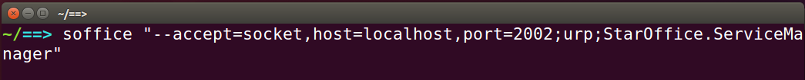
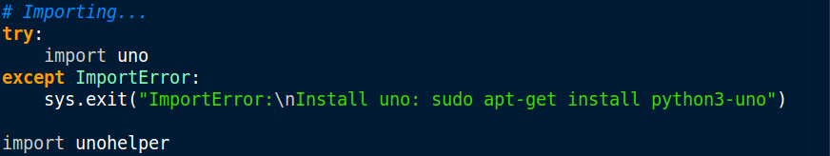
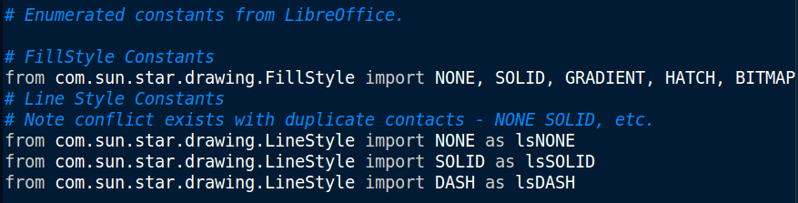
Python-UNO Bridge – Launching / Importing
Launching soffice.bin with a communication port.
Importing Python-UNO bridge.
Python setting up LibreOffice Enumerated Constants

Slide 7
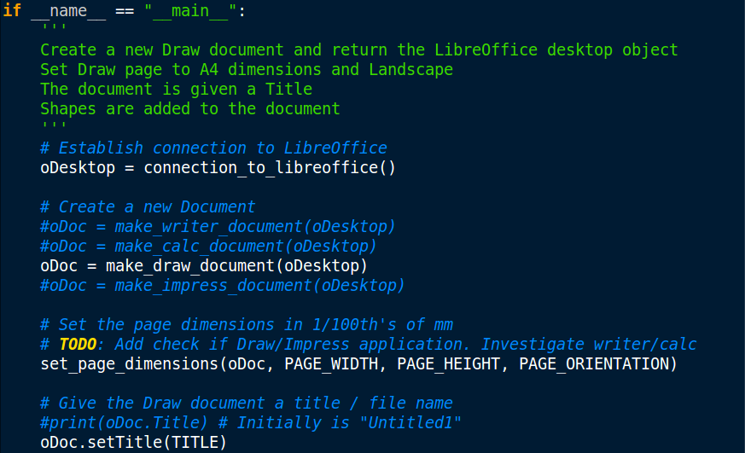
Python-UNO Bridge – Creating Draw Document

Slide 8
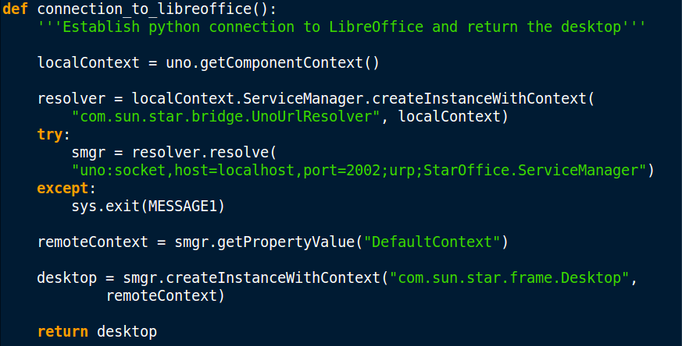
Python-UNO Bridge – Establishing connection
Returns the “desktop” (i.e. top level) of LibreOffice.

Slide 9
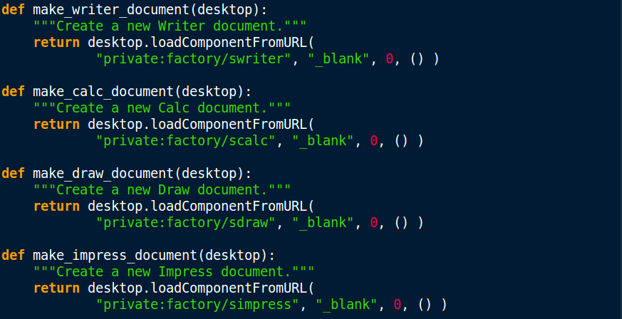
Python-UNO Bridge – Creating blank documents
Choice of creating blank Writer,Calc, Draw and Impress documents

Slide 10
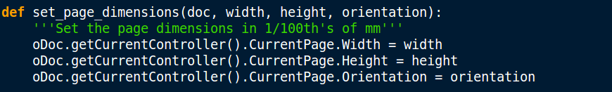
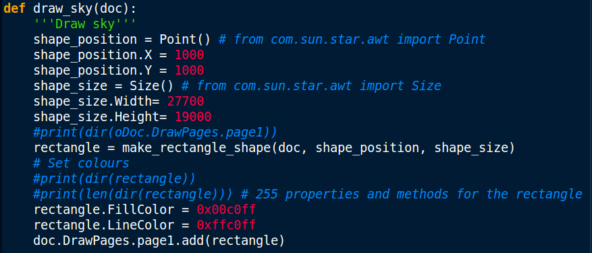
Python-UNO Bridge – Interacting with the LibreOffice API
Page setup
Insert Rectangle

Slide 11
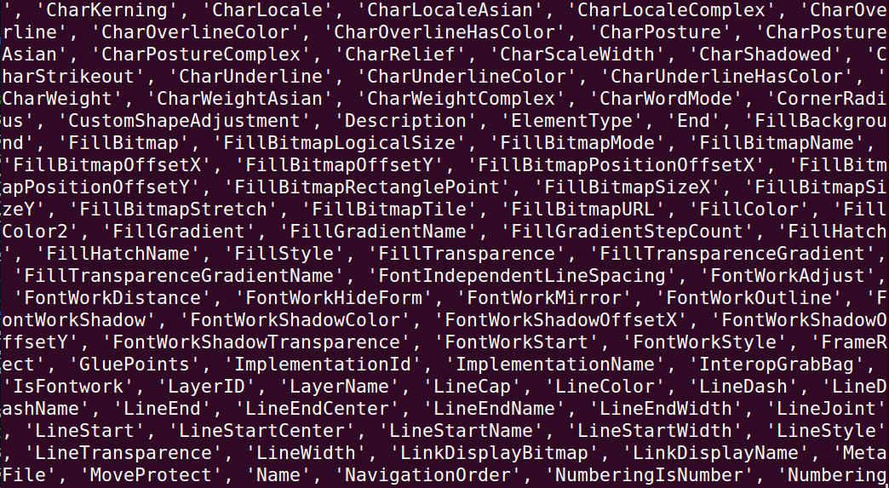
Python-UNO Bridge – Introspection: print(dir(rectangle))
255 x Properties and Methods of a LibreOffice rectangle object

Slide 12
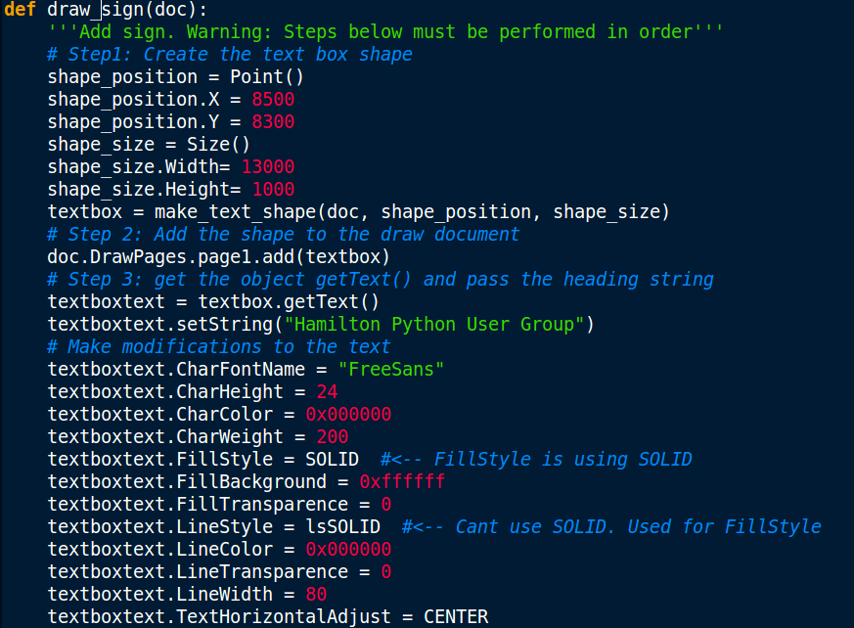
Python-UNO Bridge – textbox & textboxtext objects

Slide 13
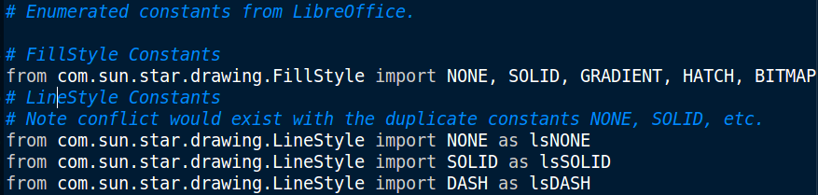
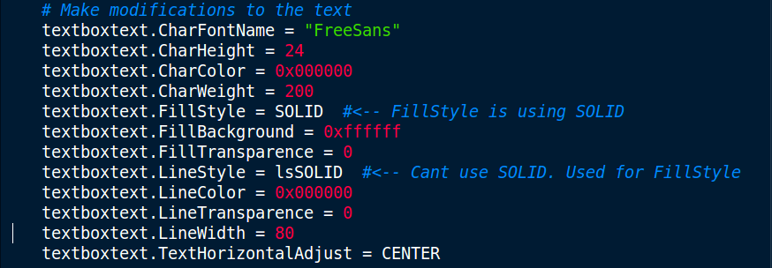
Python-UNO Bridge – Overloaded emunerated constants

Slide 14
Python-UNO Bridge - References / Tutorials / Examples
__end__
Example program: pythonhouse.py
Script screen shots in this presentation are from pythonhouse.py
Example code: https://github.com/mirkonasato/pyodconverter
A Python script that automates office document conversions from the command line using LibreOffice or OpenOffice.org.
http://www.openoffice.org/udk/python/python-bridge.html#intro
https://wiki.openoffice.org/wiki/Using_Python_on_Windows
.

